Slide 1
ML2 2.3
Complex Machine Learning Model
Random Forest
By: Jordan Novelli

Slide 2
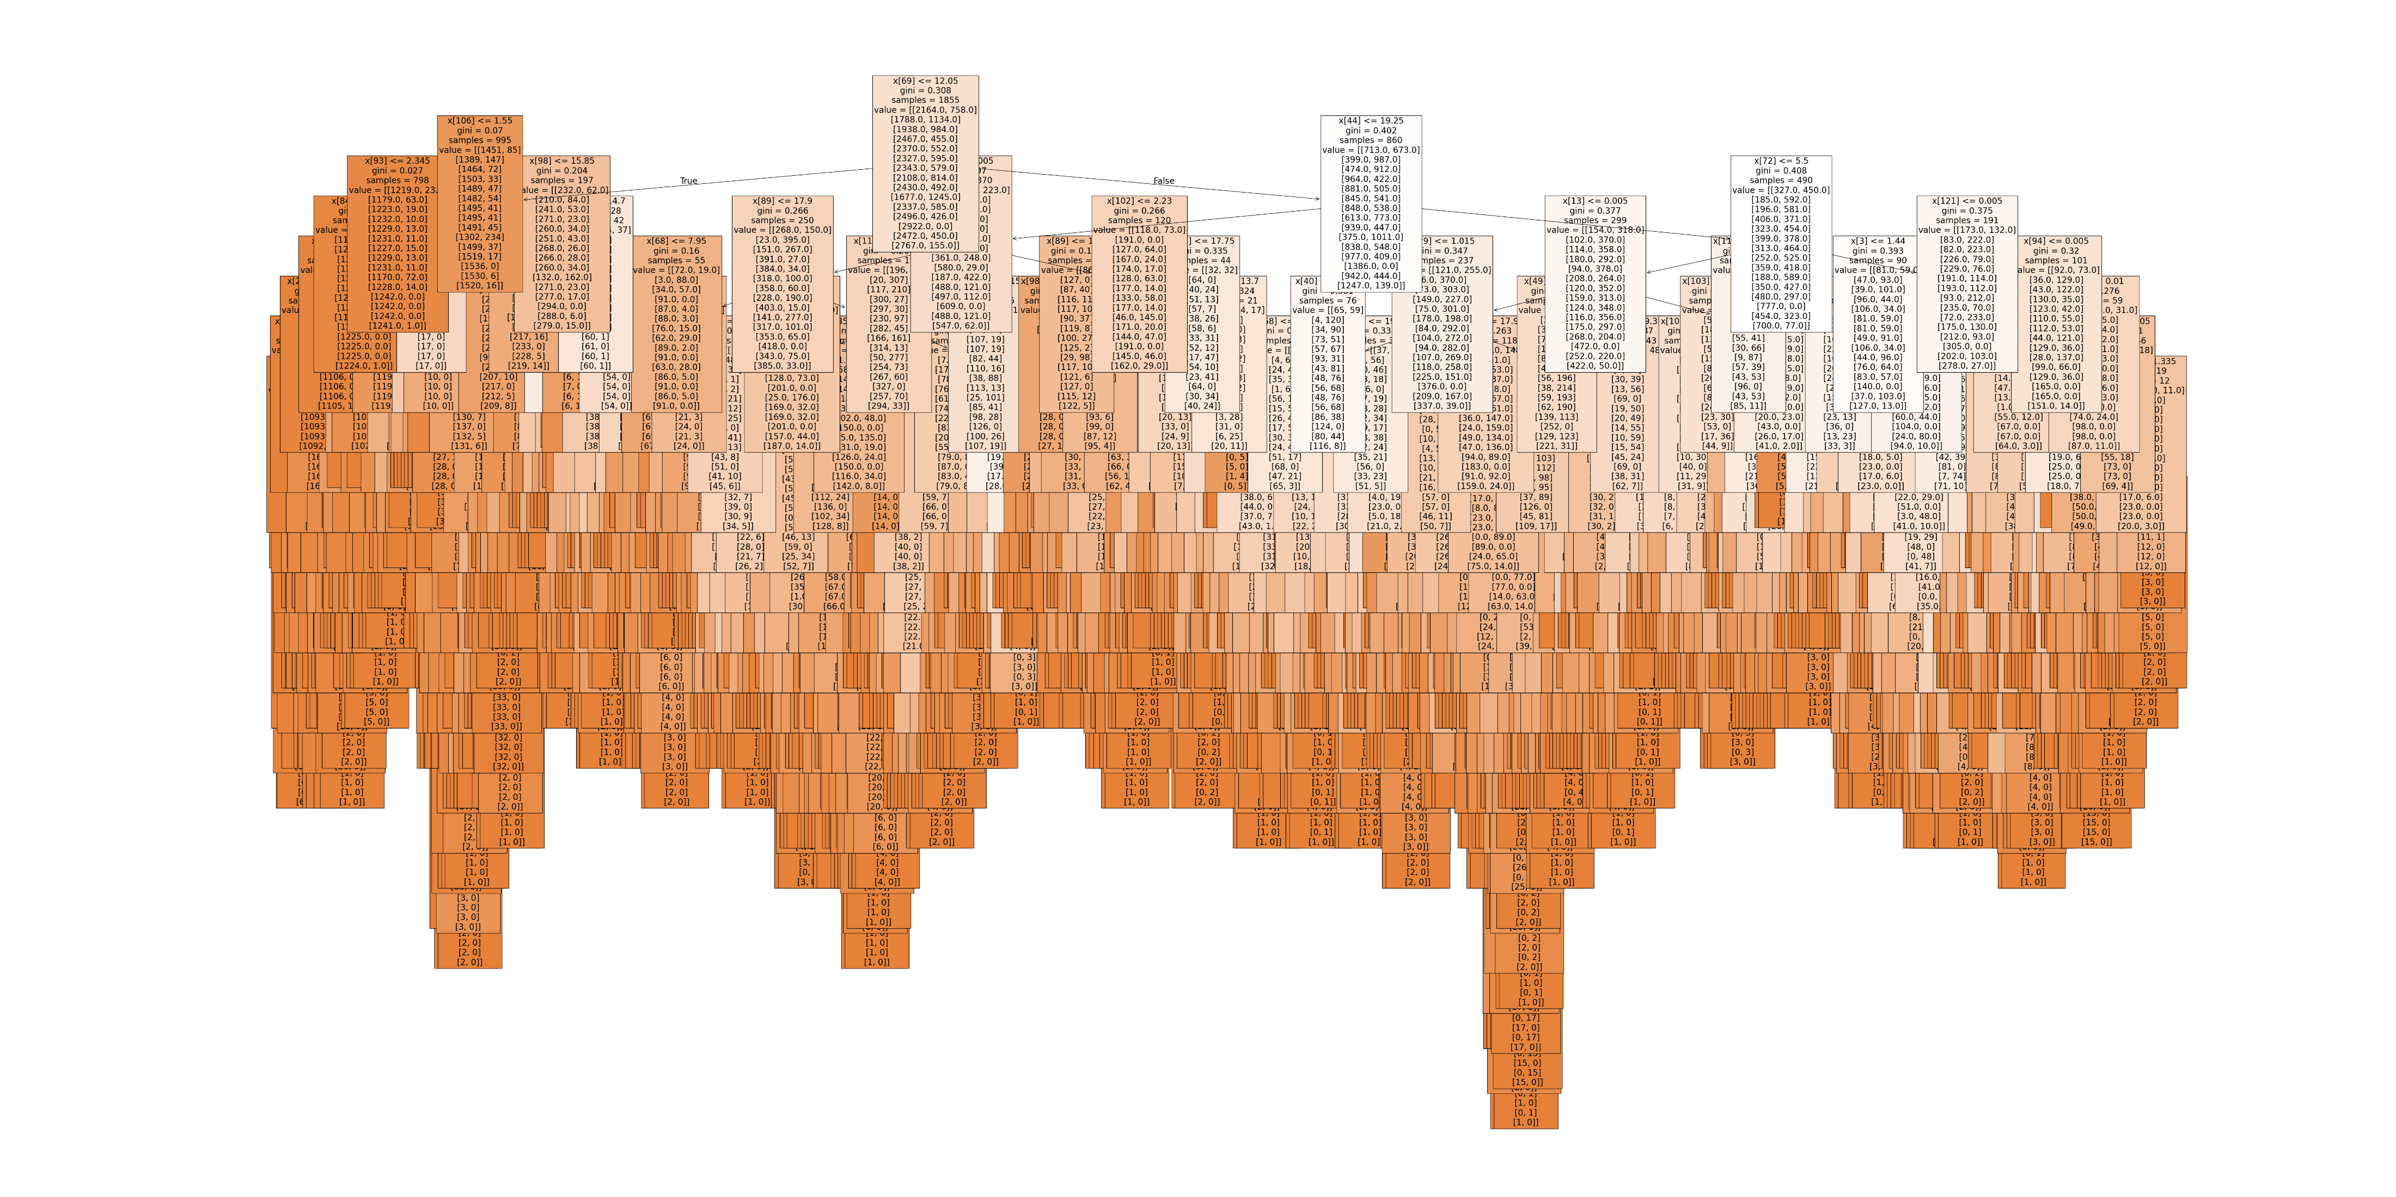
Random Forest
In the first Random Forest I ran, I selected a single decade to examine.
I chose decade 1960
This Random Forest had all 15 weather stations and all 15 pleasant weather predictions.
This RF is quite large and obviously difficult to read.
Our Model Accuracy was: 0.6032831737346102

Slide 3
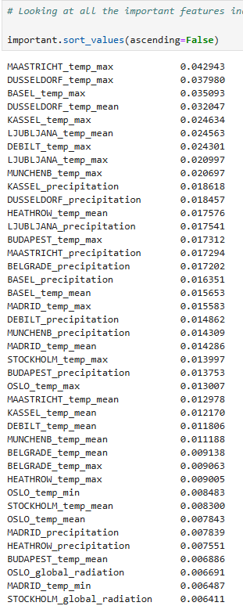
Random Forest Feature Importance
When creating Feature Importance there were 135 values.
Looking within a range of 0.042943 – 0.011188 (top 29 items) we can see that Temp_Max, Temp_Mean and Precipitation are the top features with the most influence.

Slide 4
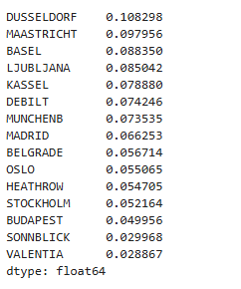
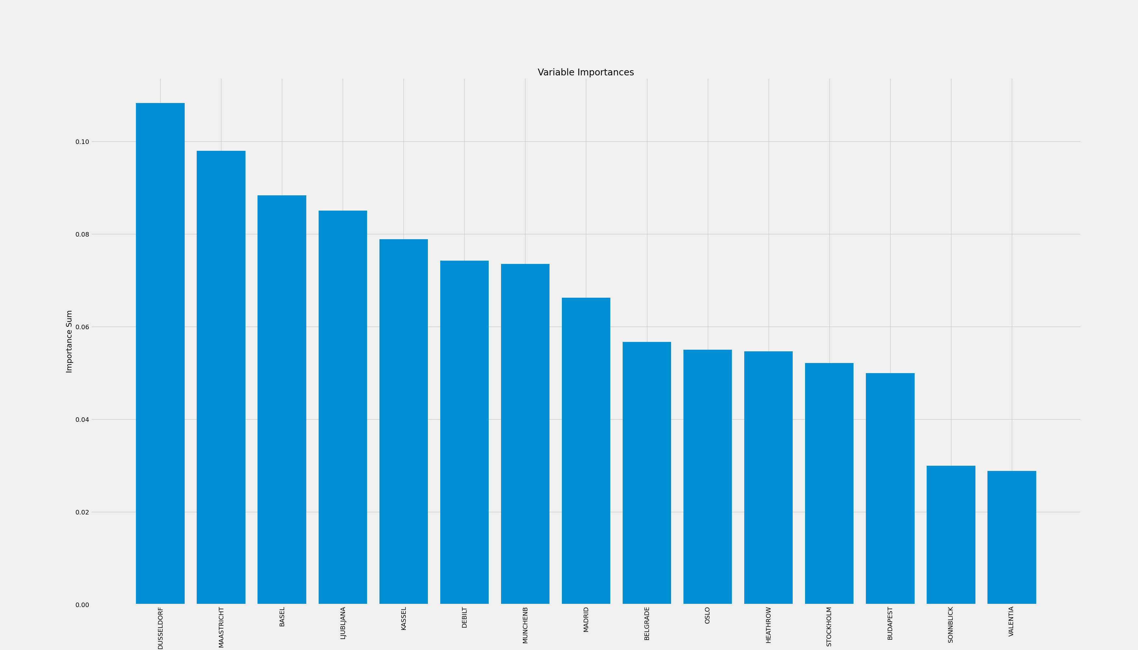
Random Forest Bar Chart
Our bar chart shows the weather stations with the most influence (left to right)
We can even look at the sum of each weather station to visualize it’s rank.

Slide 5
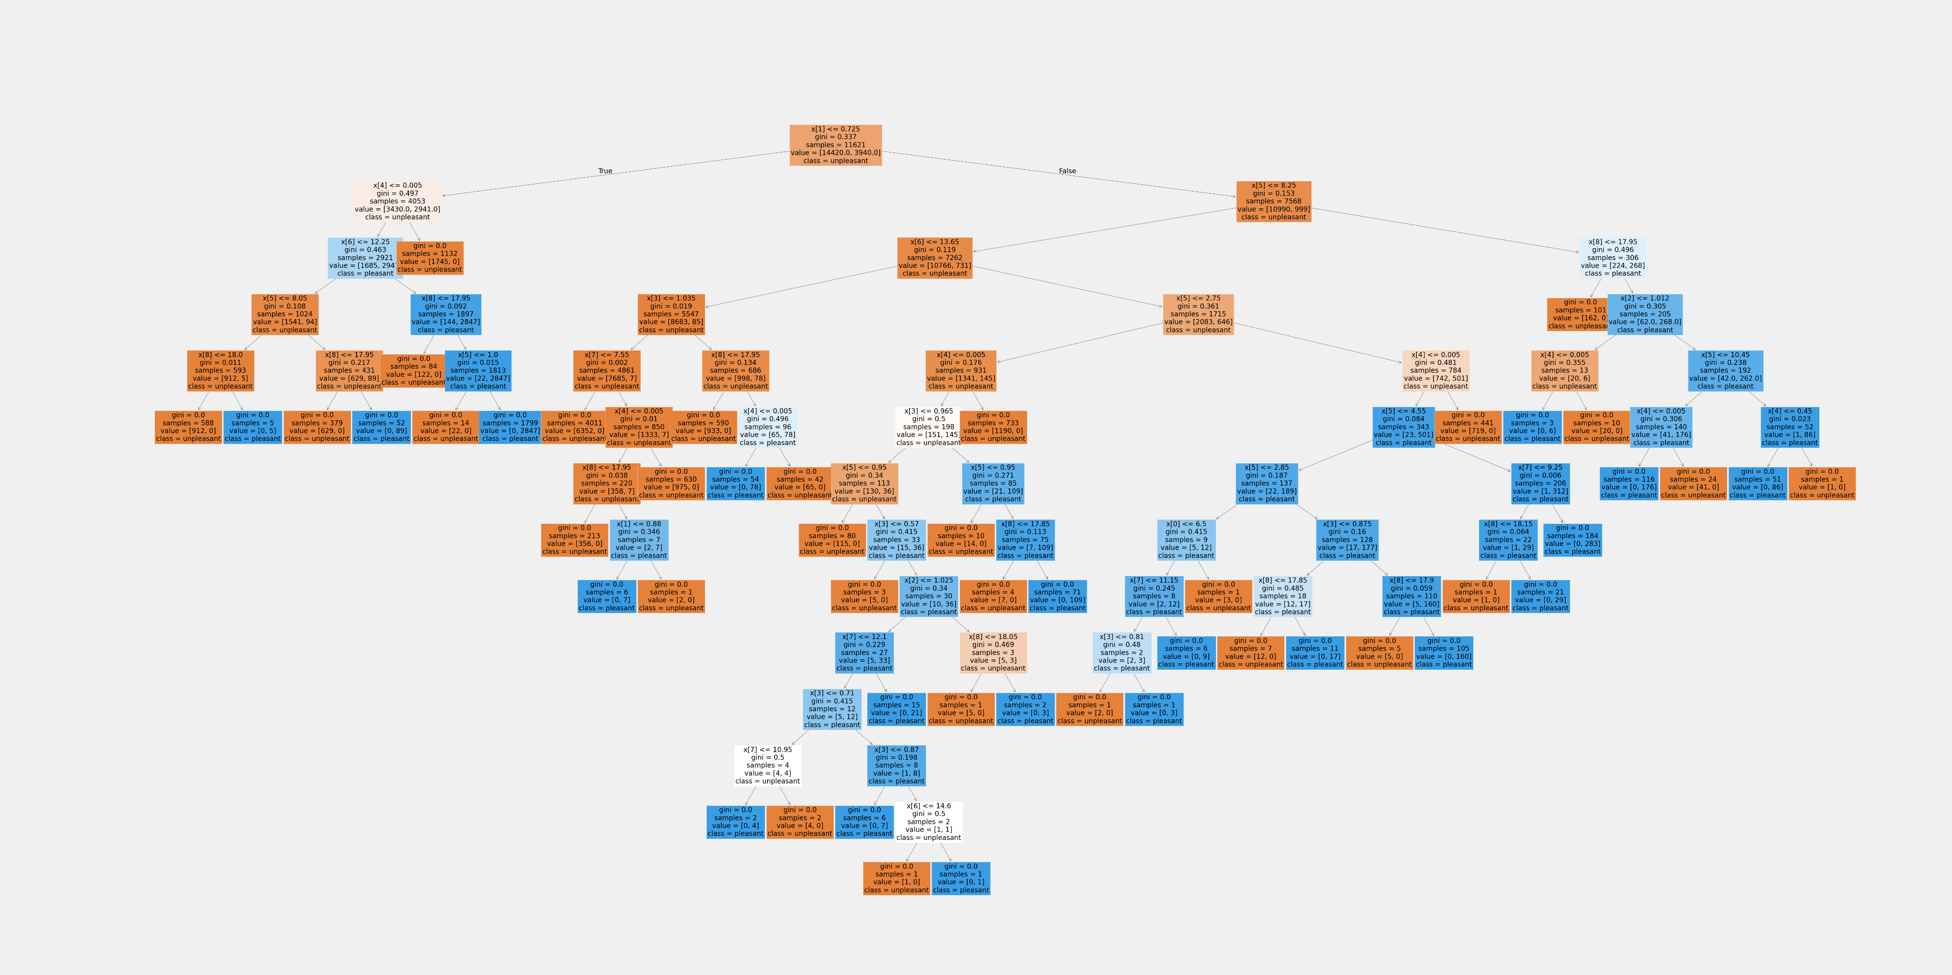
Dusseldorf
I began running RF for the top 3 weather stations. Dusseldorf was the highest influencing weather station according to the first RF.
This RF has all the years within the data but only the observations for Dusseldorf
This RF is quite a bit smaller and a lot easier to read.
Our Model Accuracy was: 1.0 – I assume simply because we are working with one weather station.

Slide 6
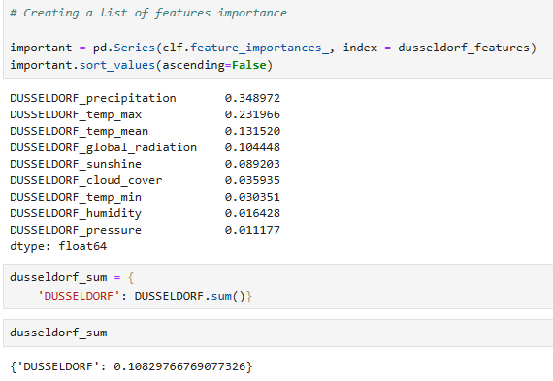
Dusseldorf Feature Importance
When creating Feature Importance there were 9 values.
We can see that like in the main RF, our top influencing features are precipitation, temperature max and temperature mean.
Our sum for Dusseldorf is 0.108

Slide 7
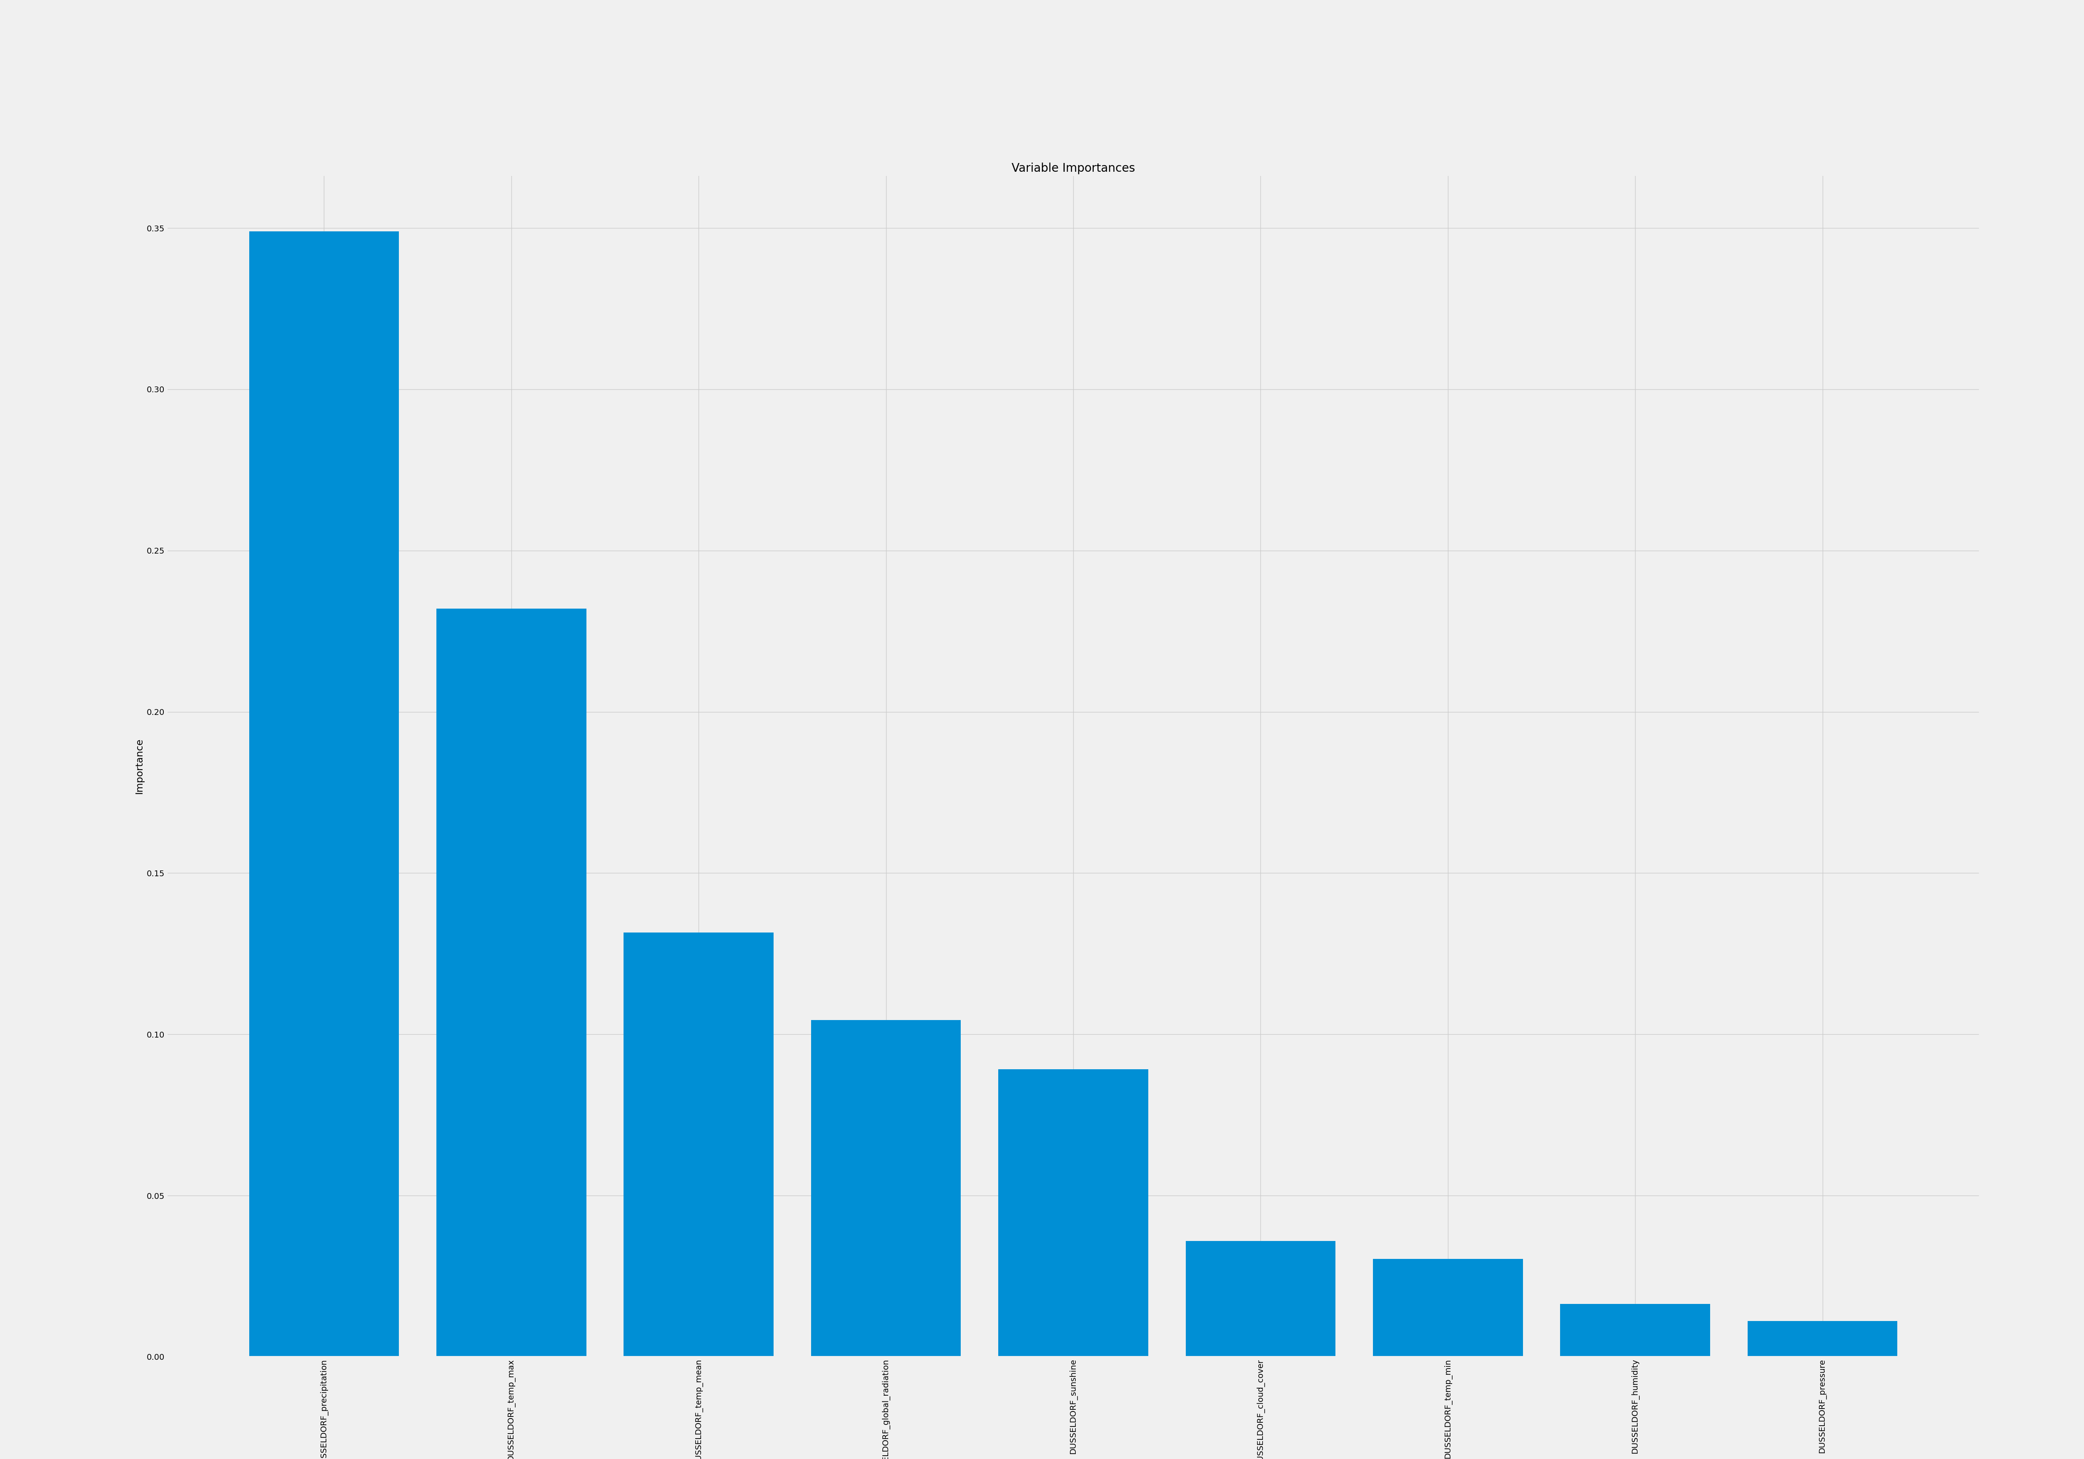
Dusseldorf Bar Chart
Our bar graph matches nicely with our feature importance.
Precipitation has a large influence with Temperature max coming in as strong second.
Temperature mean is less than half of precipitation so there’s not a large amount of influence.

Slide 8
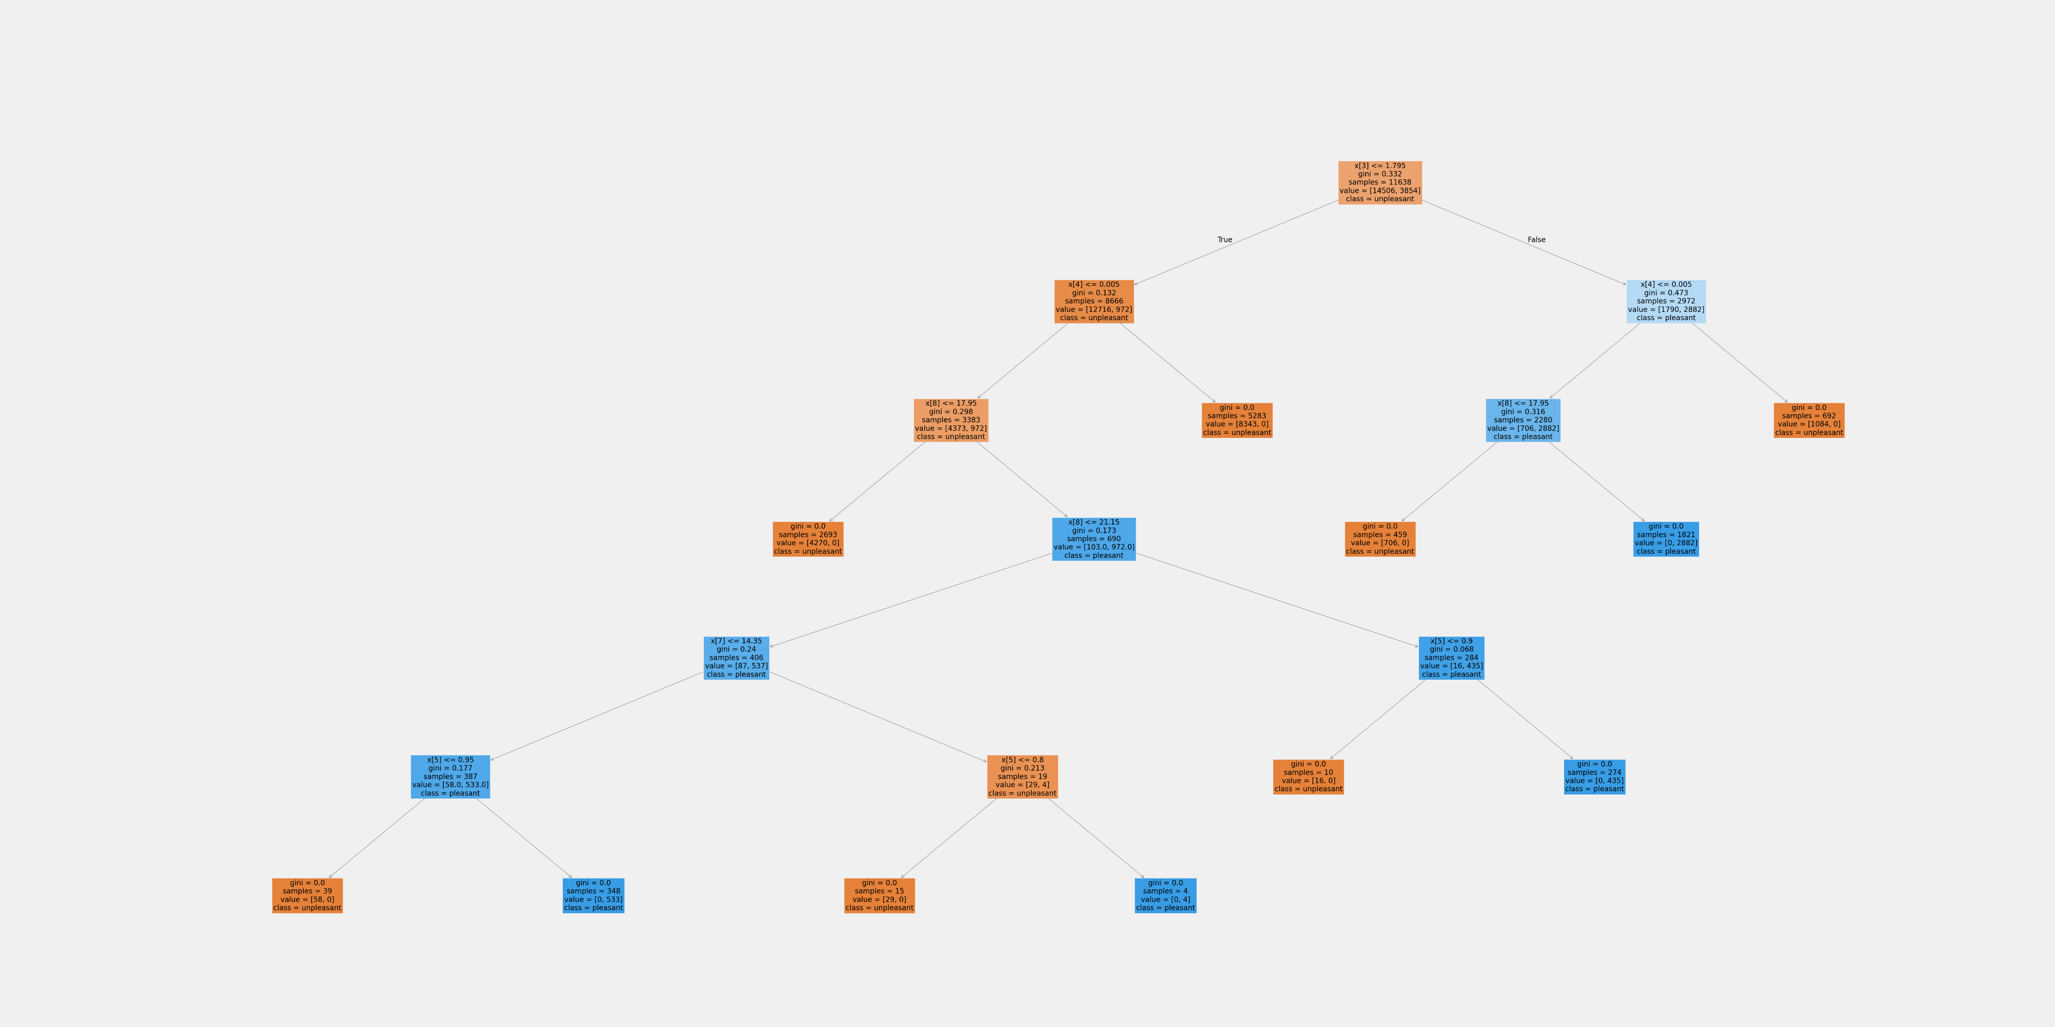
Maastricht
Running the second weather station with influence and this RF is so simple.
Again, this RF has all the years available but, we’re only focusing on Maastricht weather station.
Our Model Accuracy was: 1.0 – I assume simply because we are working with one weather station.

Slide 9
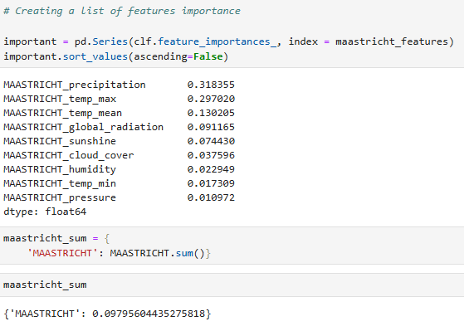
Maastricht Feature Importance
When creating Feature Importance there were 9 values.
Again, we can see that like in the main RF, our top influencing features are precipitation, temperature max and temperature mean.
Our sum for Maastricht is 0.0979

Slide 10
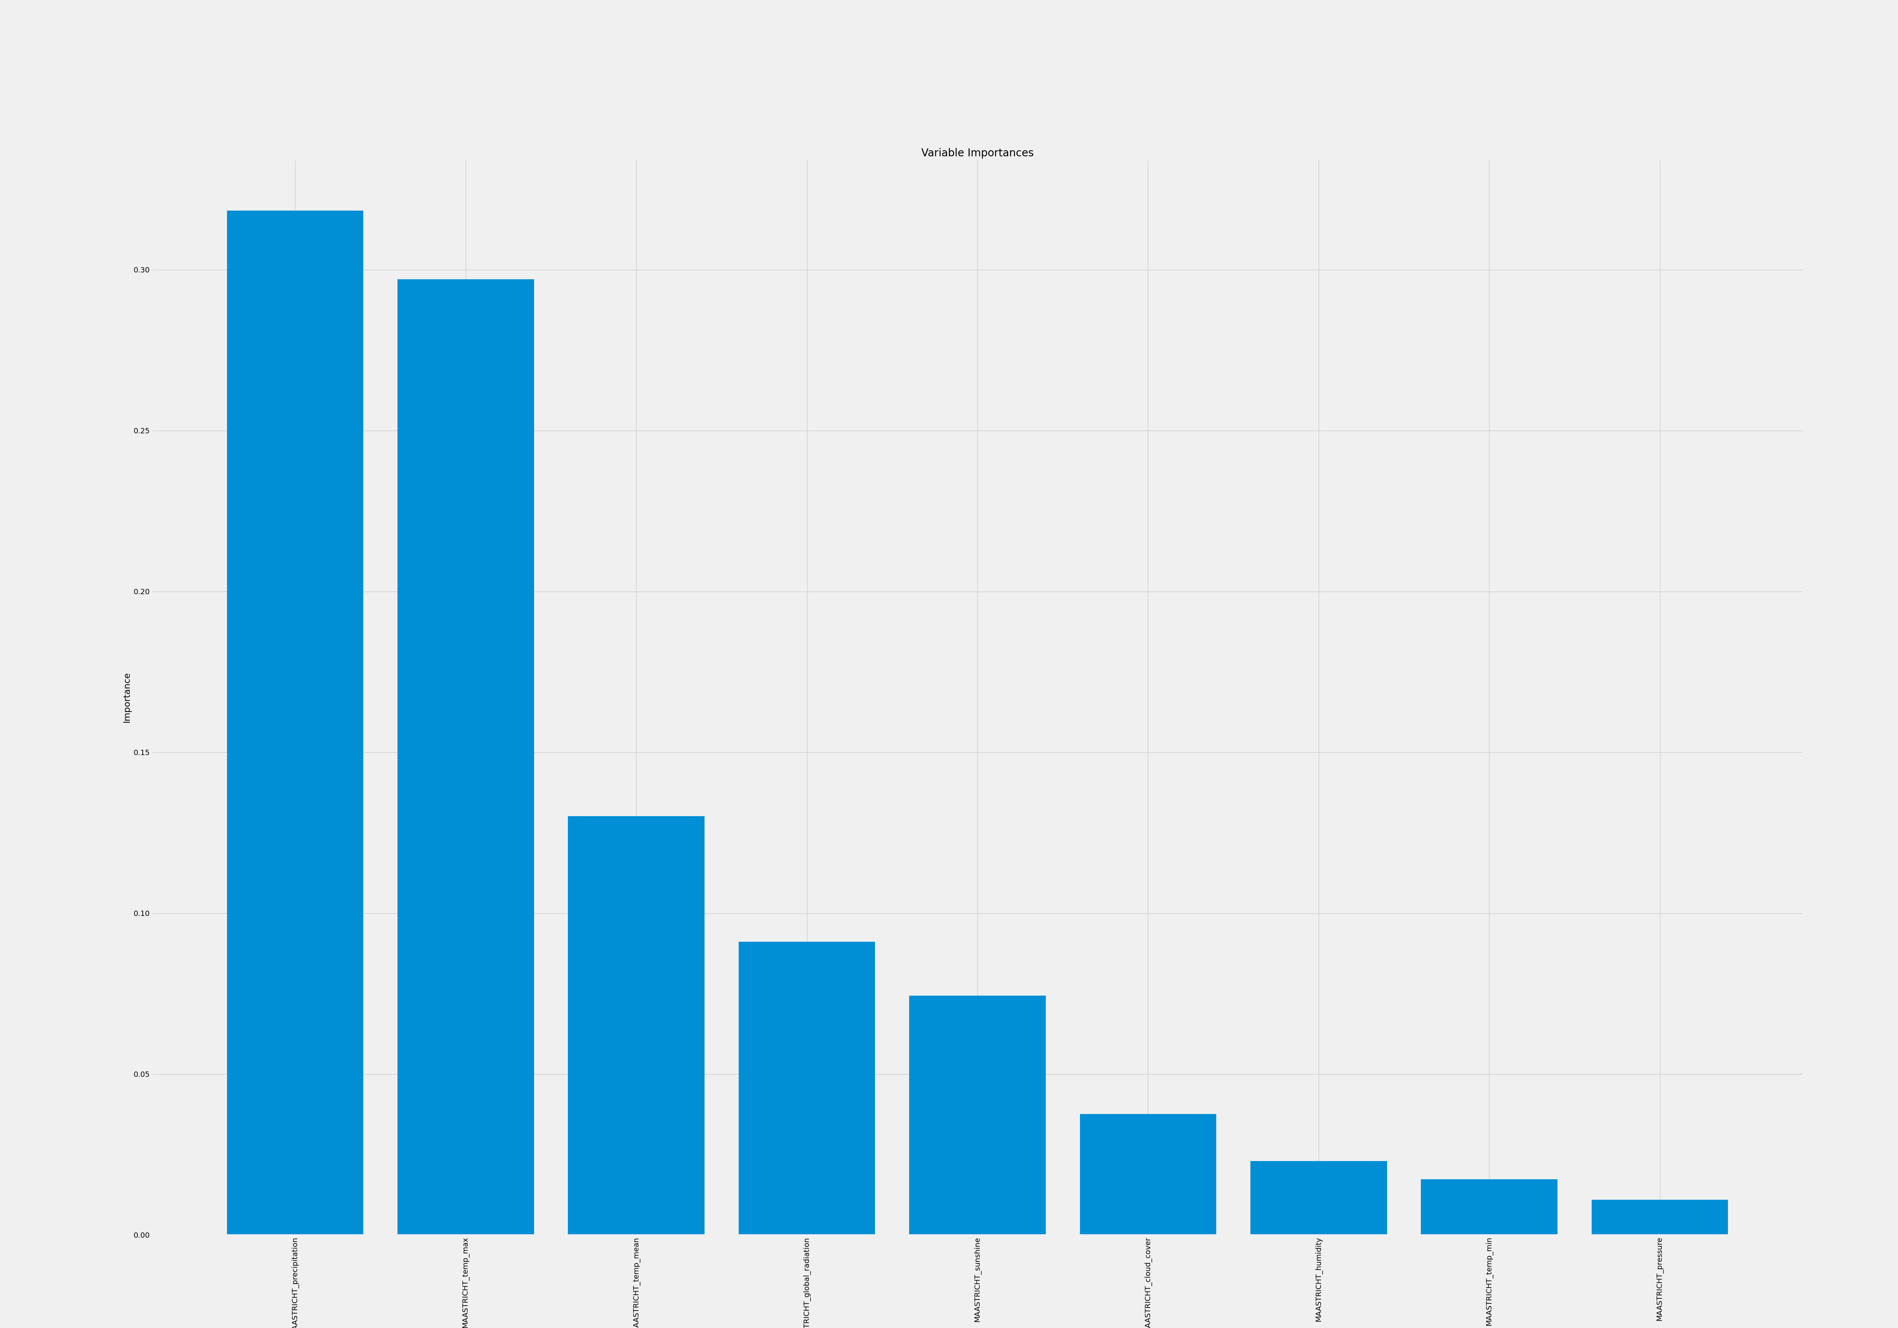
Maastricht Bar Chart
Our bar graph matches nicely with our feature importance.
Precipitation has a large influence with Temperature max as an extremely strong runner up!
Temperature mean is less than half of precipitation so there’s not a large amount of influence, either.
Comparing Dusseldorf with Maastricht we are starting to see that temperature mean isn’t as influential as we thought.

Slide 11
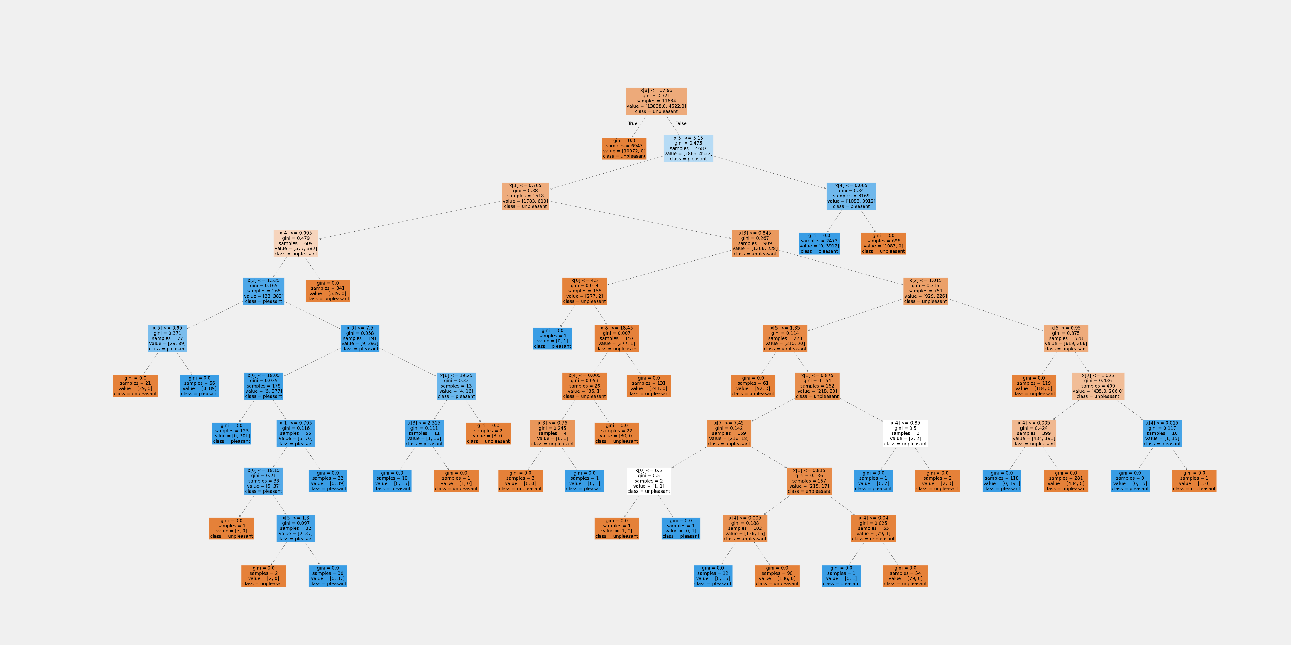
Basel
Our third weather station and this RF is a little busier than the previous two weather stations but, it’s not too bad..
This RF has all the years within the data but only the observations for Basel
Our Model Accuracy was: 1.0 – I assume simply because we are working with one weather station.

Slide 12
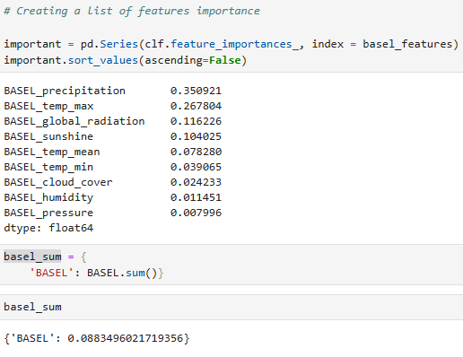
Basel Feature Importance
We are still observing 9 Feature Importance .
We can see that like in the main RF, our top influencing features are precipitation, temperature max but Basel offers a difference!
Basel third feature is global radiation. This would lead me to believe that perhaps Basel is closer to the equator.
Our sum for Basel is 0.088

Slide 13
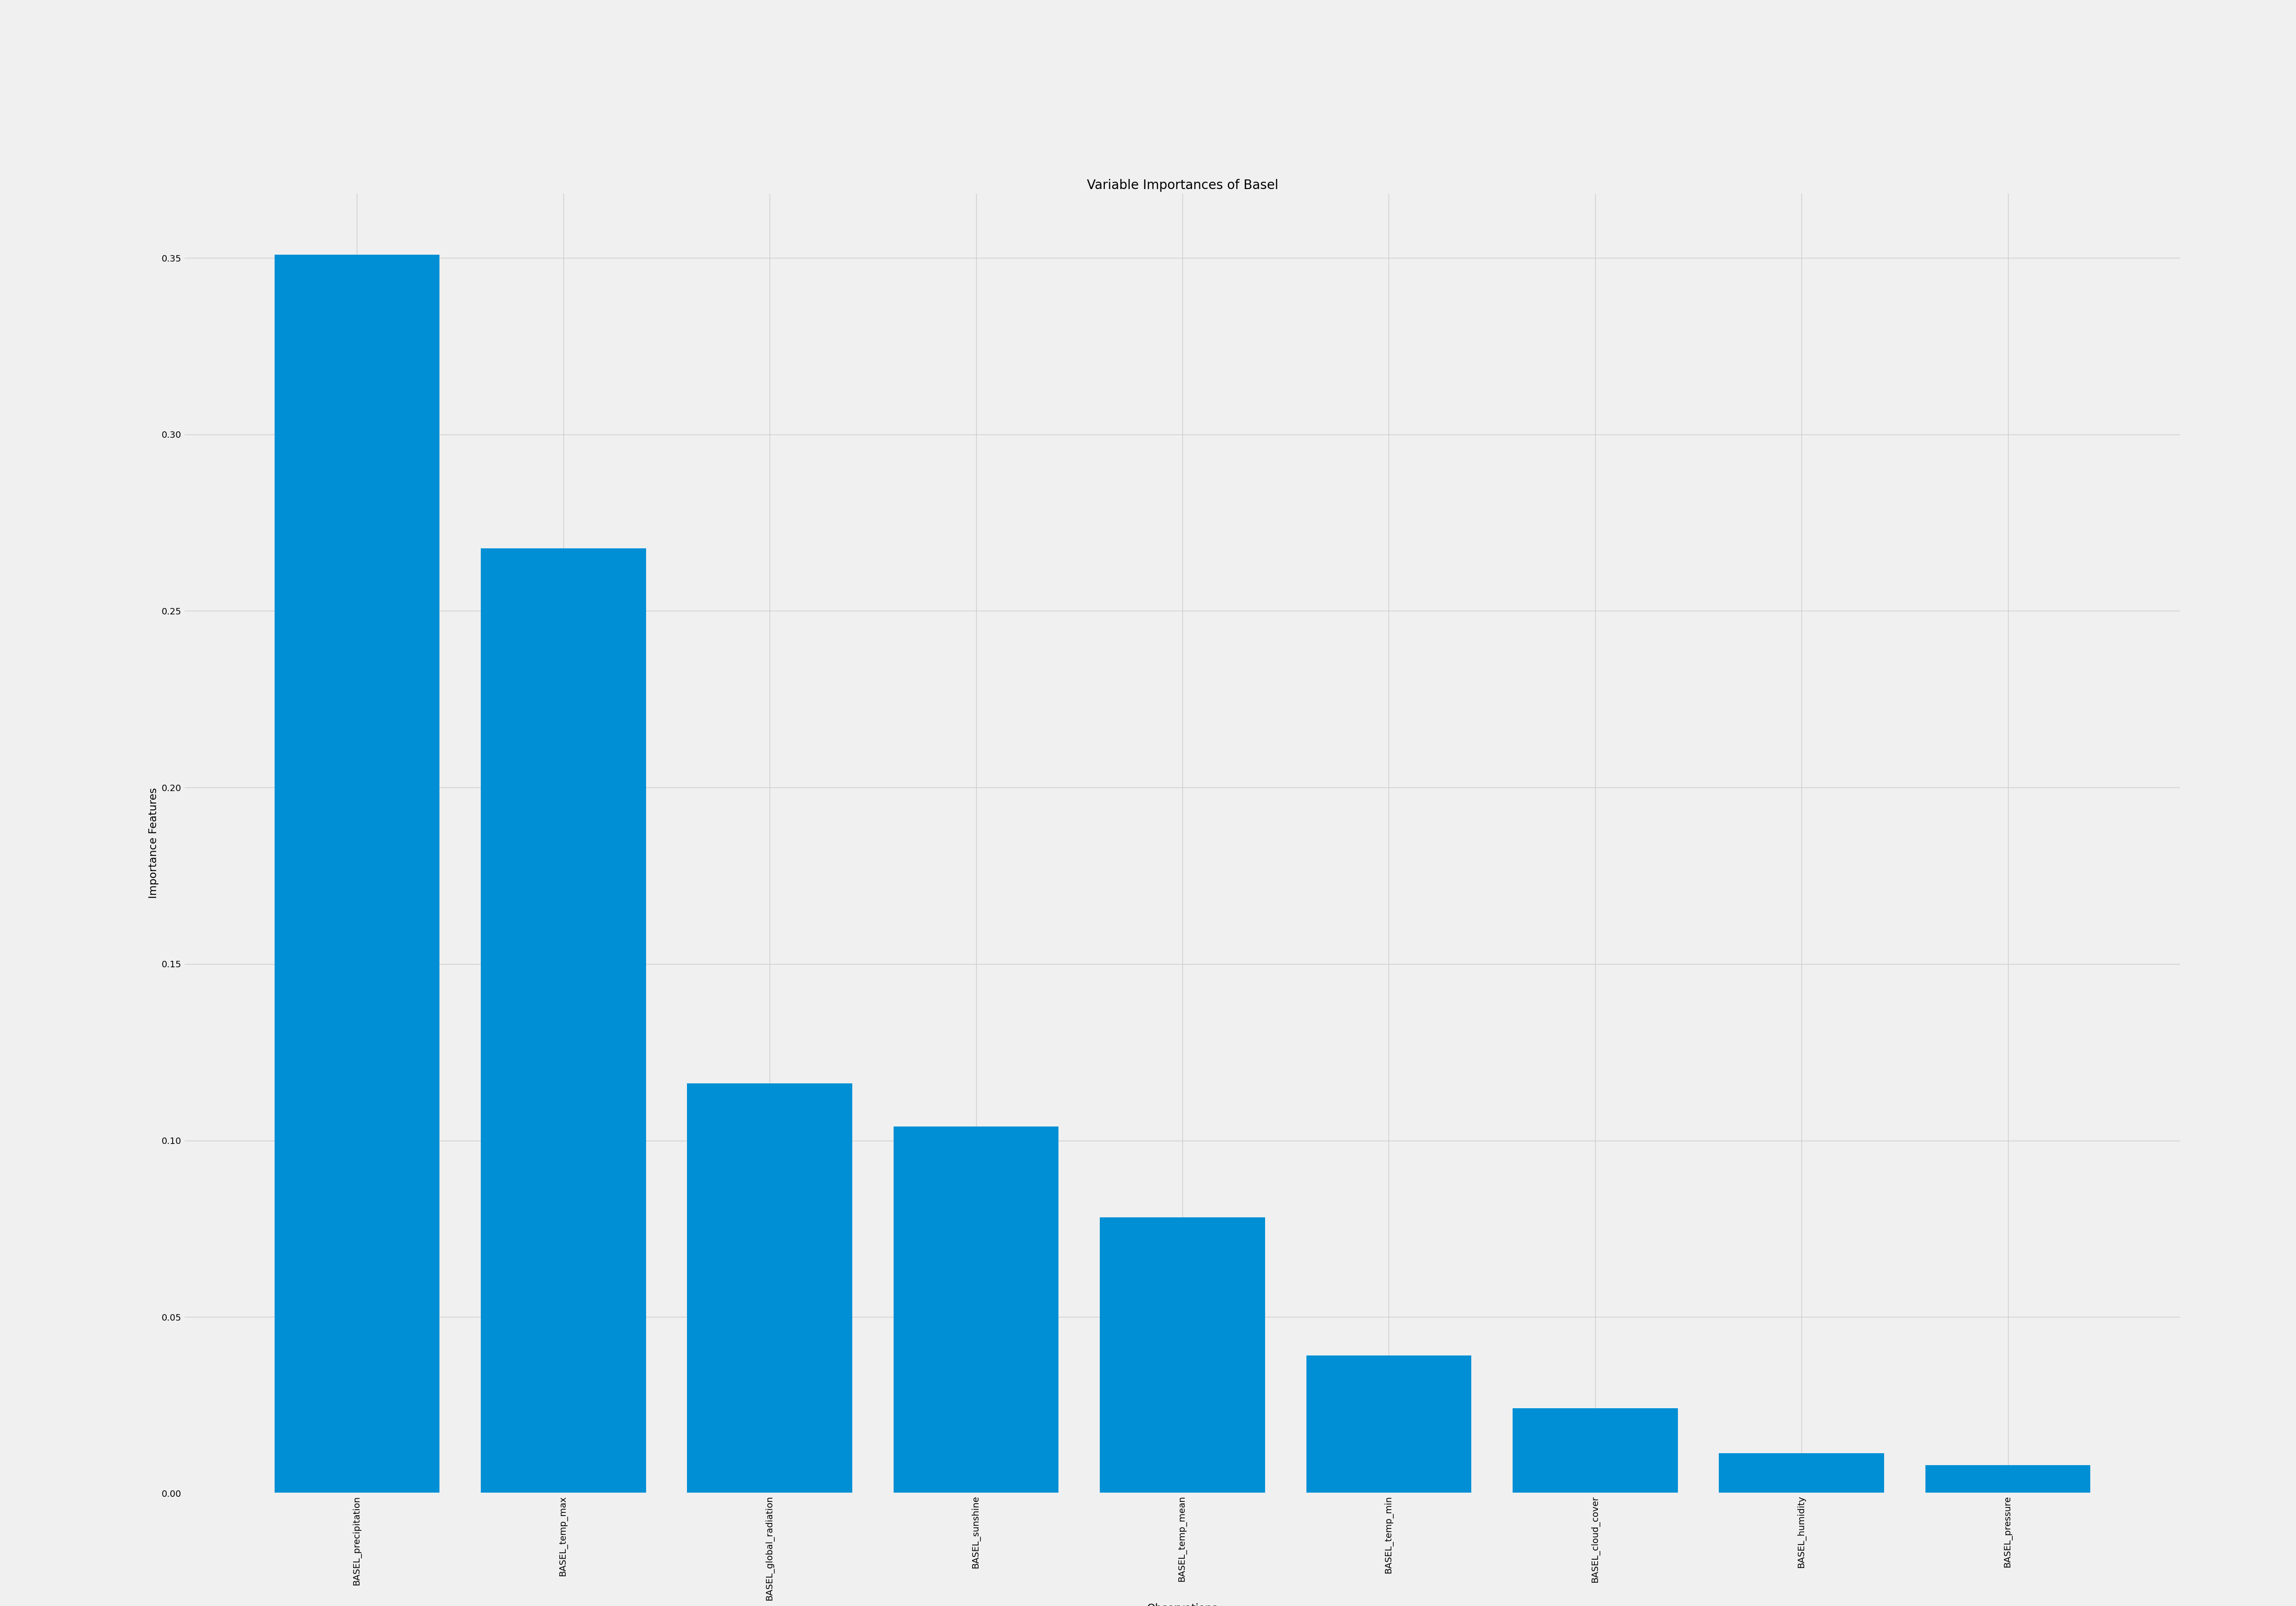
Basel Bar Chart
Our bar graph matches nicely with our feature importance.
Precipitation has a large influence with Temperature max coming in as strong second.
The Global Radiation is less than half of precipitation so there’s not a large amount of influence.

Slide 14


Conclusion
Our random Forest and Feature Importance have begun to point us in the right direction for understanding what influences a good day.
With precipitation, otherwise knowns as rain or hail, we can conclude that when the day is wet and rainy or even snows the day is not aligned with “pleasant” weather.
When a day has high temperatures, those days are also not considered “pleasant” weather.
Precipitation and temperature max have been our top influencers of unpleasant and pleasant weather. If these two parameters are low then we are more likely to have a day with pleasant weather.

Slide 15
END

